Slide 2
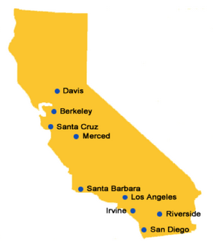

Slide 3
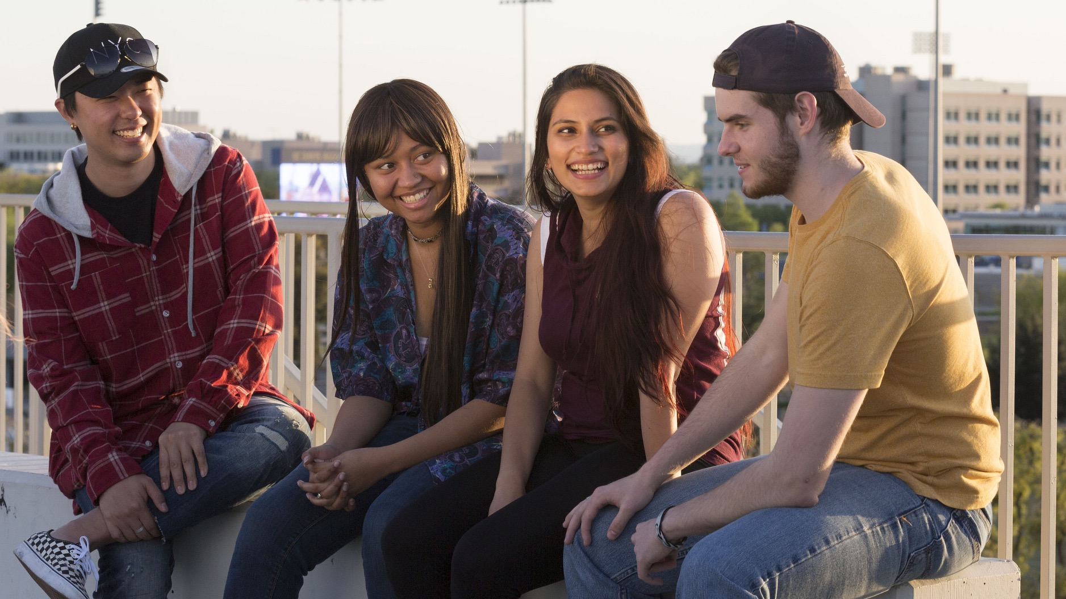
Notes:
Share a personal story to get things going and connect with your audience
Story prompt
Share a story about when you were the one sitting in the audience, deciding what to do with your future. Show that you can relate, that you know what it’s like to have such a big decision coming up that will shape so many different aspects of life.
Along with the story, reassure students that UC Davis has so many opportunities to explore, connect and find friends: Orientation, residence halls, classes with supportive classmates and professors, student organizations, Outdoor Adventures, First Year Aggie Connections (voluntary groups for first-years organized around a topic and guided by a staff or faculty mentor), intramural and club sports, cultural centers — UC Davis is a place where you can thrive and continue to shape your life, with many people and resources available to help you grow and make decisions.
And now I want to talk about some of the things UC Davis is known for…

Slide 4
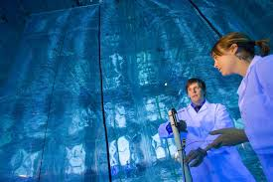

Slide 5
Freshman Admission Requirements
Complete the following “a–g” subjects with a C grade or better:
a. History/social science | Two years
b. English (or language of instruction) | Four years
c. Mathematics | Three years*
d. Laboratory science | Two years*
e. Language other than English (or second language) | Two years*
f. Visual and performing arts | One year
g. College preparatory elective | One year
*UC recommends one additional year of study
Earn a GPA of 3.00 or higher (GPA of 3.40 or higher for nonresidents)
Take either the ACT with Writing or the SAT with Essay by December 2019
Notes:
“A-G,” GPA and exam requirements for freshmen
These admission requirements are for those who will apply during their final year of high school to enter UC Davis as a freshman

Slide 7
Grade point average (GPA)
Test scores
Courses completed/planned
Honors coursework
Eligibility in the Local Context (ELC)
Quality of senior-year program of study
Educational opportunities in high school
Performance in academic subject areas
Achievements in special projects
Improvements in academic performance
Special talents, achievements and awards
Participation in educational preparation/academic enrichment programs
Academic accomplishment within life experiences
Geographic location
Freshman Selection Process 14 Criteria
Notes:
Selection criteria used by all UC campuses

Slide 10
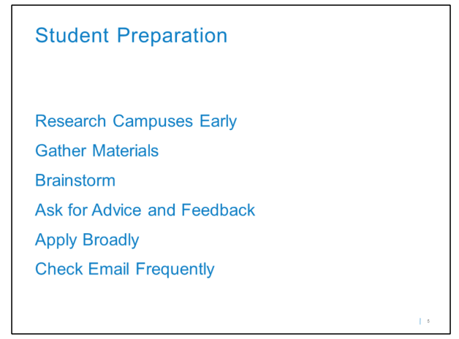

Slide 14
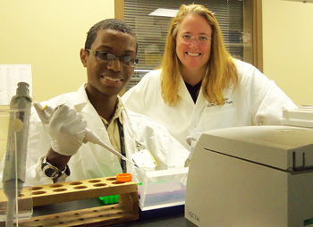

Slide 15
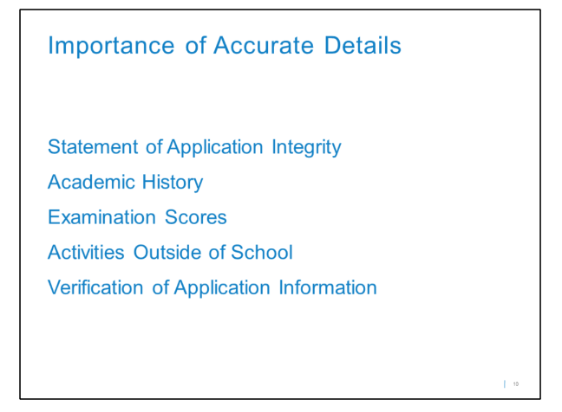

Slide 16
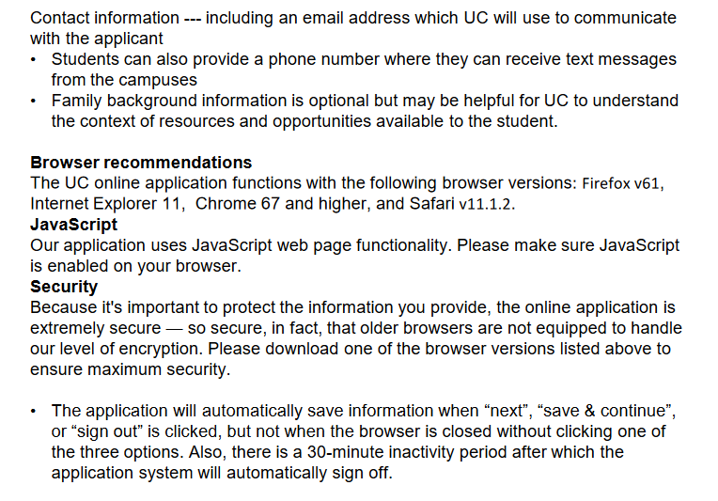

Slide 19
Personal Insight Questions
Leadership
Creative expression
Greatest talent or skill
Making use of educational opportunities or barriers
Navigating through challenge/impact on academics
Academic subject that inspires you/taking it further
Making your world better
Stand out qualities

Slide 20
