Slide 1
NCSA NEXT COLLEGE STUDENT ATHLETE Helping Your Athletes Find Their Best College Fit
Want to Play College Sports?
Create Profile Online for Coaches
TEXT “ncsa19” to “797979”
PRESENTED BY:
Senior Director of Regional Recruiting, Julian Jenkins

Slide 2
Today’s recruiting game plan
Academics & Eligibility
Athletic Recruiting Timeline
Gaining Exposure

Slide 3
academic Requirements
Complete 16 NCAA Core Courses
> 2.3 GPA in core courses
16 NCAA Core Classes
Complete 10 core courses before the 7th Semester
Earn an SAT combined score or ACT sum score that matches your core course GPA on NCAA sliding scale
www.ncaa.org “Student-Athlete Registration”
Talk to your counselor to keep track of classes
** NCAA D2& D3 schools & NAIA set their own Admissions and Eligibility Standards
http://www.playnaia.org/page/eligibility.php
http://www.ncaa.org

Slide 4
ELIGIBILITY Requirements
How to plan your high school courses to meet the 16 core-course requirement:
4 x 4 = 16
4 English courses (one per year)
4 math courses (one per year)
4 science courses (one per year)
social science (and/or additional) courses (one per year)
MUST COMPLETE 10 CORE COURSES PRIOR TO THE 7TH SEMESTER OF HIGH SCHOOL ACADEMIC CAREER TO BE A FULL QUALIFIER
If looking to play at either the Division I or II level, registering with the eligibility center is important to do, USUALLY DURING THE sophomore year OF THE STUDENT ATHLETE
$90 One time fee
NCAA rules require you to be registered with the NCAA Eligibility Center in order to be recruited, to go on an official visit, to receive an offer of FINANCIAL aid or to sign a National Letter of Intent

Slide 5
Division Breakdown
Division I
Division II
Division III
Larger student populations
Athletic Scholarships
More revenue is generated by the athletic department (more scholarships given)
Increased time demands of student athletes
More television exposure on major networks
Emphasis on life balance; between athletics & academics
Equivalency Scholarships
Less revenue generation by athletic departments (less scholarships given)
Many schools compete regionally
Smaller student populations
Academically driven institutions
“Academic Scholarships”
Shortened seasons
More Schools

Slide 6
STUDENt RECRUITING TIMELINE
9th & 10th Grade
11th & 12th grade
9th grade
EARN THE BEST GRADES POSSIBLE
MAKE THE TEAM
START RESUME FOR COACHES
10th Grade
REGISTER WITH NCAA ELIGIBILITY
CONTINUE RESUME FOR COACHES
CAMPS/COMBINES/SHOWCASES
11TH GRADE
TAKE THE SAT OR SAT
COMMUNICATE WITH COLLEGES
VISIT COLLEGES
12TH GRADE
VISIT COLLEGES
RE-TAKE THE ACT OR SAT
COMMITT and SIGN NLI

Slide 7
Gaining exposure
Create Resume Online
Upload Video
Show Stats
Follow on Social Media
Compete at Camps/Showcases
Visit Schools

Slide 8
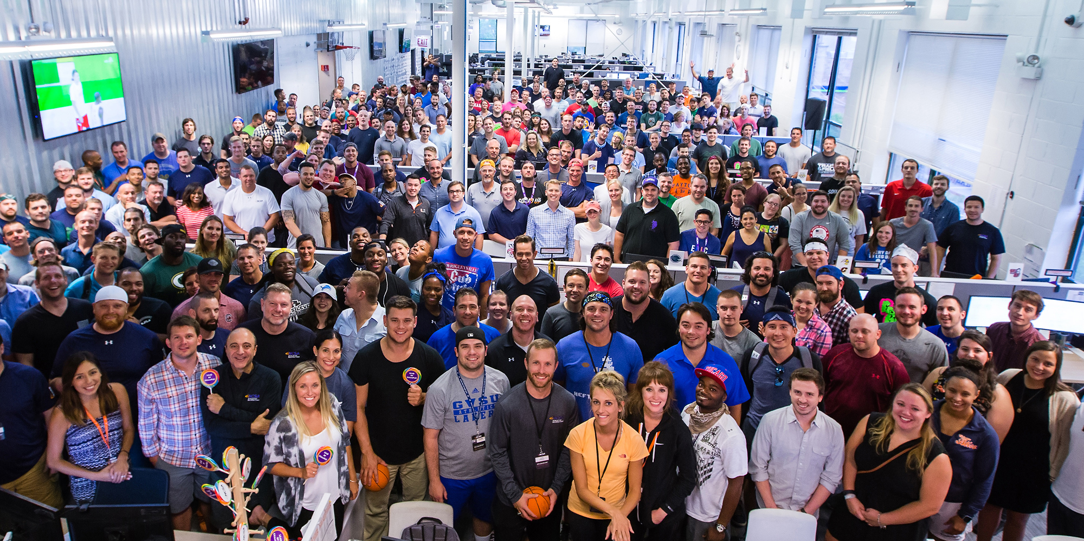
Join the Team!

Slide 9
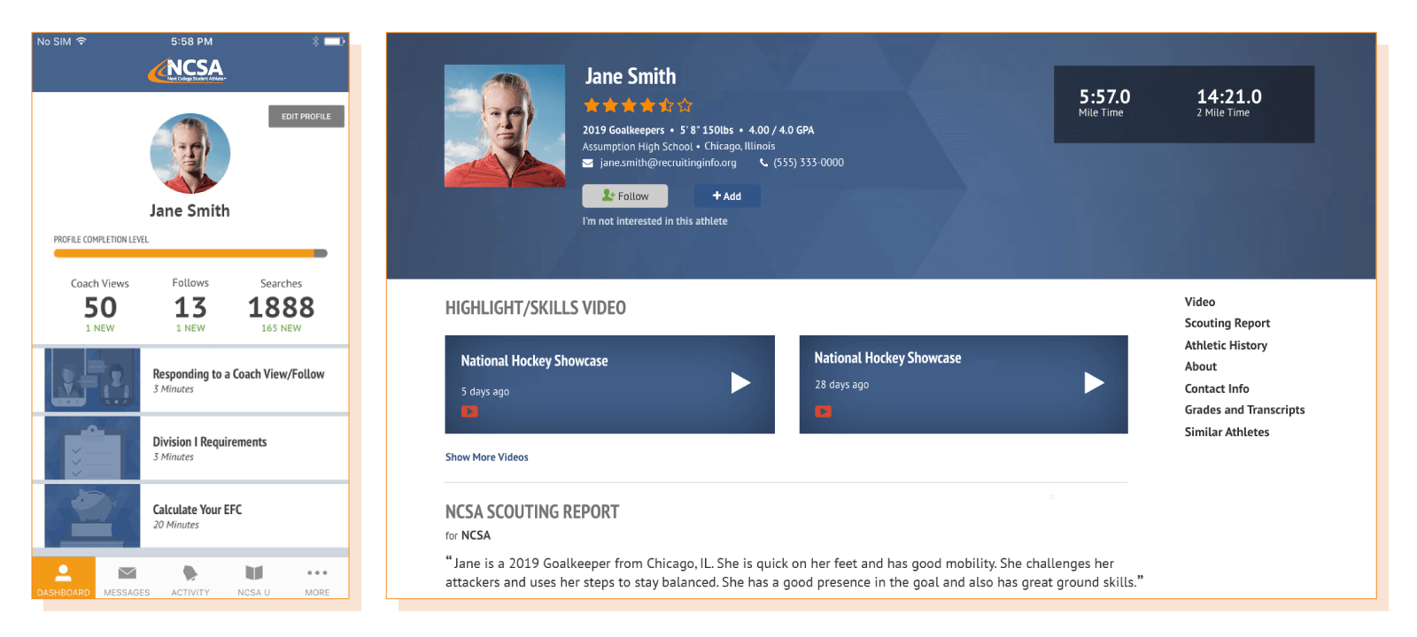
BUILD YOUR RECRUITING RESUME…ONLINE

Slide 10
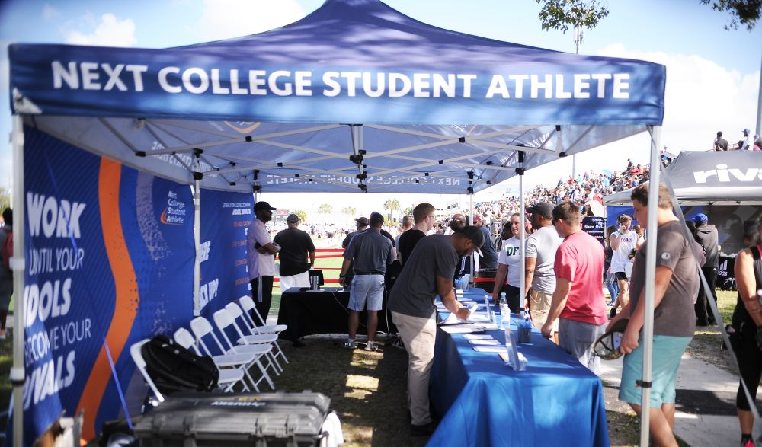
TEXT “ncsa19” to “797979” CrEatE ONLINE PROFILE TODAY!

